Slide 1

Silk City Electronics Website Prototype
By: Vixous™

Slide 2
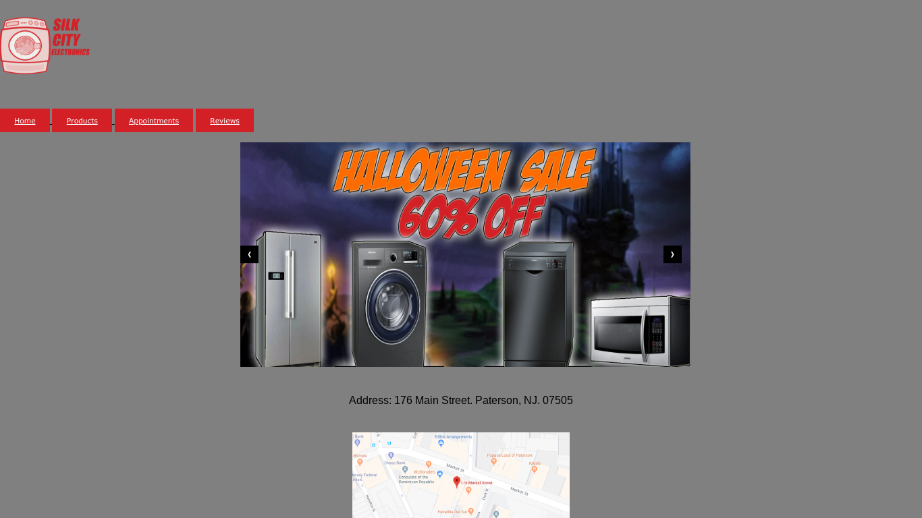
Homepage:

Slide 3
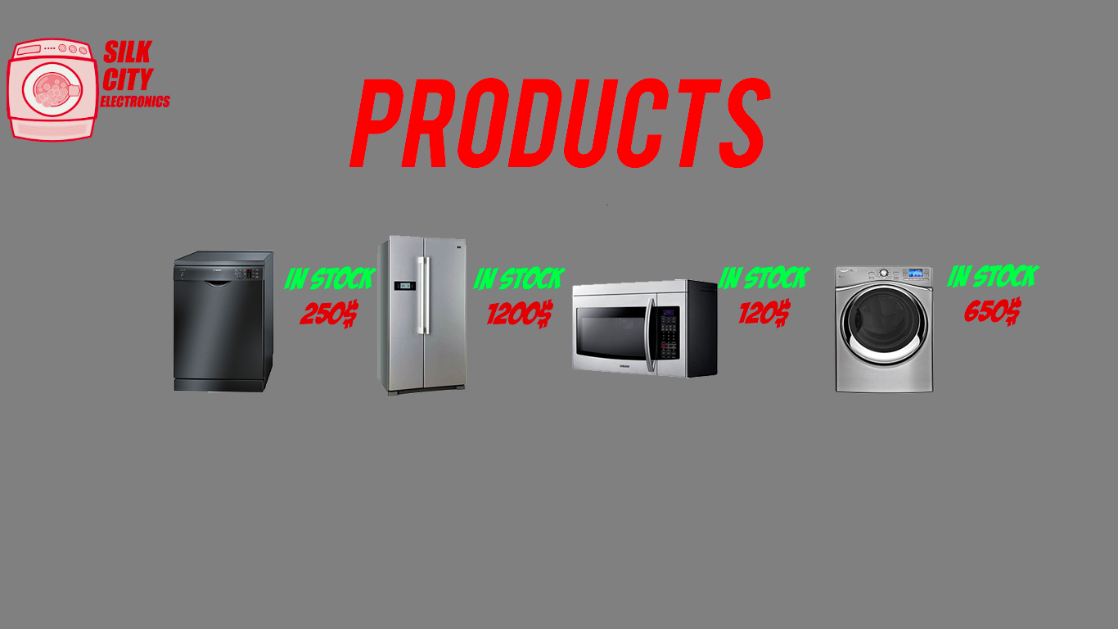
Products Page:

Slide 4
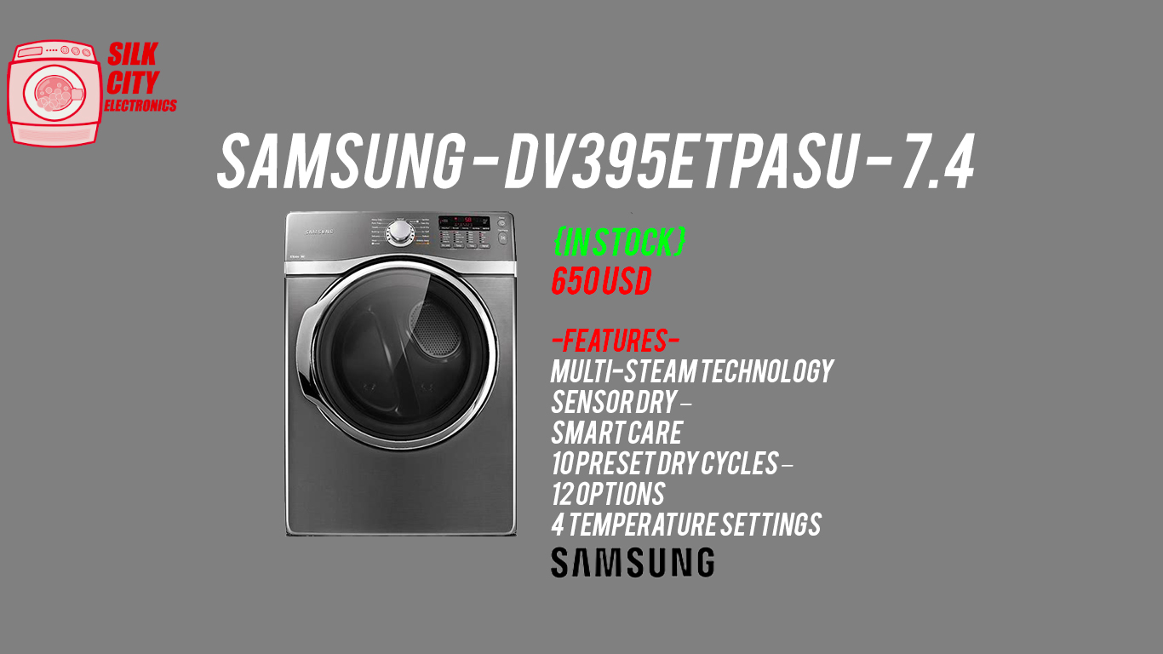

Slide 5

Customer Review Page:

Slide 6


